Slide 1
PUZ-BUG
Team Members: Juwaria Adil, Yuhao Lan, Rahul Rajendran, Panika Valecha, Yuan Xu

Slide 2
Introduction
Debugging techniques have expanded to detect more anomalies.
A software Developer must posses debugging skills.
PUZ-BUG is a puzzle game that teaches you the basics of debugging.
Mainly focused on debugging small code snippets.
Targeted on beginners and students.

Slide 3

System Functionality
Puzzle
Puzzle pieces linked to code snippets
Ability to debug and access solutions
Pre-defined Hints
Timer and reward points

Slide 4
Architectural Drivers
Clean User Interface
Debugging Platform
Data Storage for code snippets

Slide 5
Architecture Style
Our application is divided into different tiers: UI, Logic and Database
Architecture chosen: Layered Architecture
As we have 3 main layers, each of it will provide services to the layer above.

Slide 6
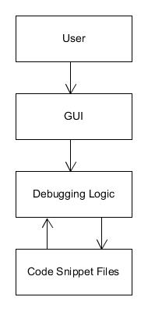
Conceptual Architecture Diagram

Slide 7
Concerns
Embed the debugging platform with the UI
When the user runs the code, just the number of errors and not the description of errors should be displayed.

Slide 8
THANK YOU

